Slide 1
Data Encryption Standard (DES)
symmetric-key block cipher
published by the National Institute of Standards and Technology (NIST).
March 1975

Slide 2
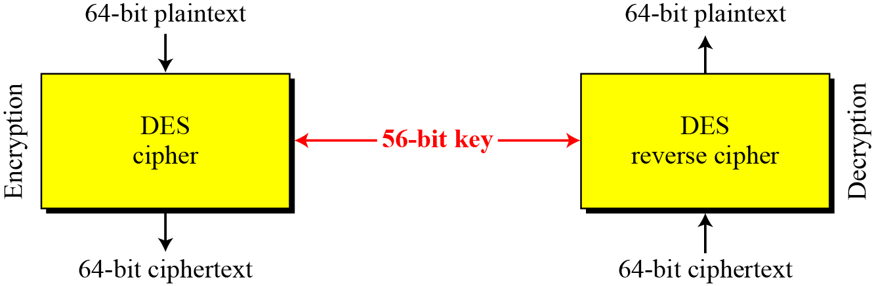
DES
Figure Encryption and decryption with DES

Slide 3
DES STRUCTURE
The encryption process is made of
two permutations (P-boxes)
initial and final permutations,
and sixteen Feistel rounds.
PT and CT are 64 bits
Cipher Key size is 56 bits
Round Key is 48 bits

Slide 4
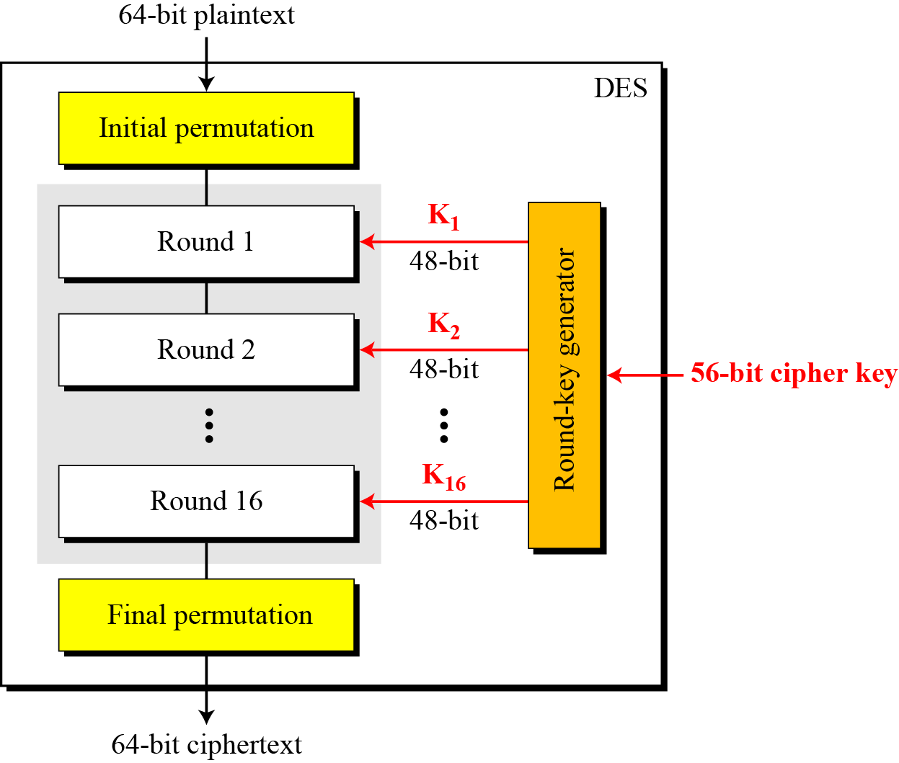
DES structure
Figure General structure of DES

Slide 5
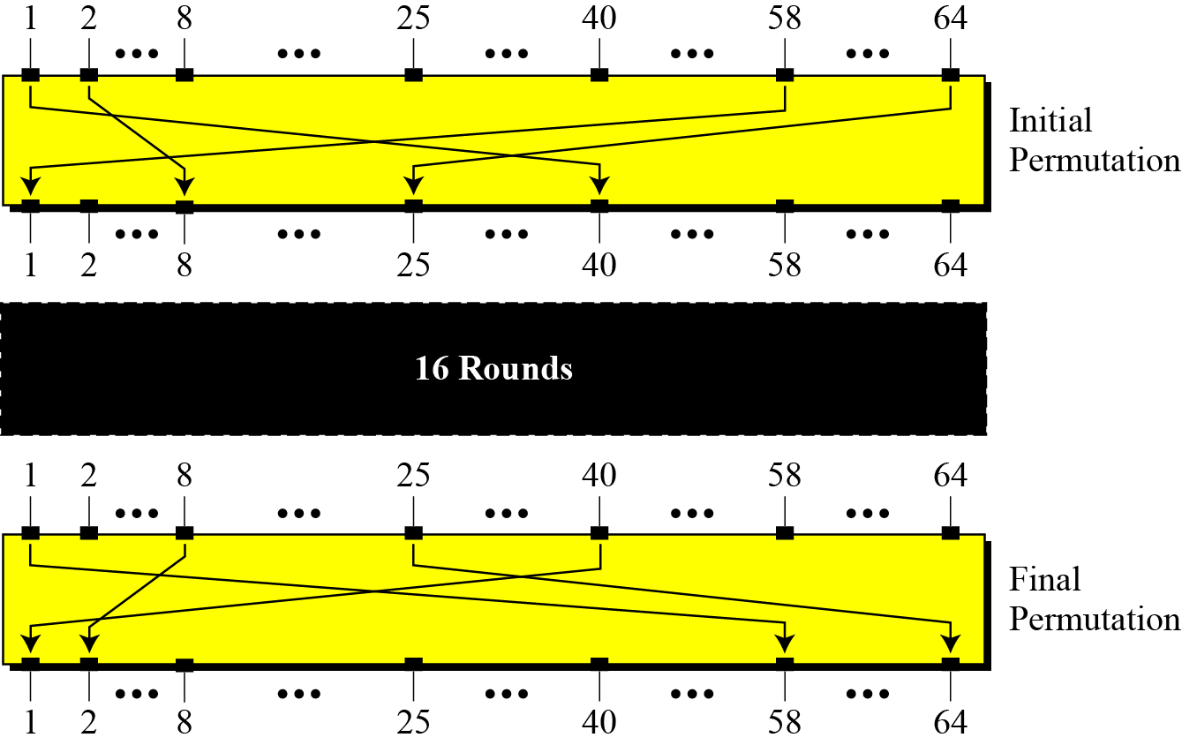
Initial and Final Permutations
Figure. Initial and final permutation steps in DES

Slide 6
Initial and Final Permutations
Table Initial and final permutation tables

Slide 7
Initial and Final Permutations
Example
Find the output of the initial permutation box when the input is given in hexadecimal as:
0000 0080 0000 0002

Slide 8
Initial and Final Permutations
Example
Find the output of the initial permutation box when the input is given in hexadecimal as:
0000 0080 0000 0002
Solution
Four 4 digit combinations- 16 digits
Expand each digit in hexa
16 * 4 = 64 bits

Slide 9
Initial and Final Permutations
Example
Find the output of the initial permutation box when the input is given in hexadecimal as:
0000 0080 0000 0002
Solution
Only bit 25 and bit 63 are 1s; the other bits are 0s. In the final permutation.

Slide 10
Initial and Final Permutations
Example
Find the output of the initial permutation box when the input is given in hexadecimal as:
0000 0080 0000 0002
Solution
Only bit 25 and bit 64 are 1s; the other bits are 0s. In the final permutation, bit 25 becomes bit 64 and bit 63 becomes bit 15. The result is

Slide 11
Initial and Final Permutations
Example
Prove that the initial and final permutations are the inverse of each other by finding the output of the final permutation if the input is
Solution
The input has only two 1s; the output must also have only two 1s. Using Table 6.1, we can find the output related to these two bits. Bit 15 in the input becomes bit 63 in the output. Bit 64 in the input becomes bit 25 in the output. So the output has only two 1s, bit 25 and bit 63. The result in hexadecimal is

Slide 12
Initial and Final Permutations
The initial and final permutations are
straight P-boxes
are inverses of each other.
have no cryptography significance in DES.

Slide 13
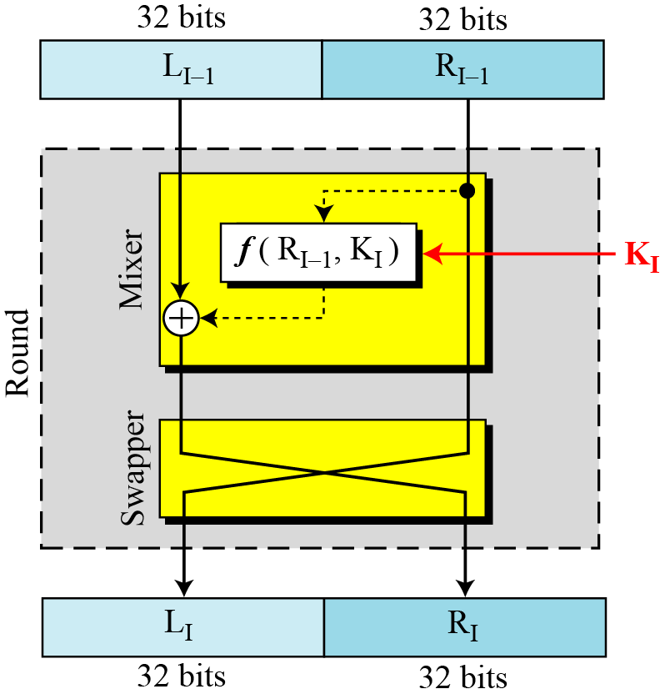
Rounds
DES uses 16 rounds. Each round of DES is a Feistel cipher.
Figure A round in DES (encryption site)

Slide 14
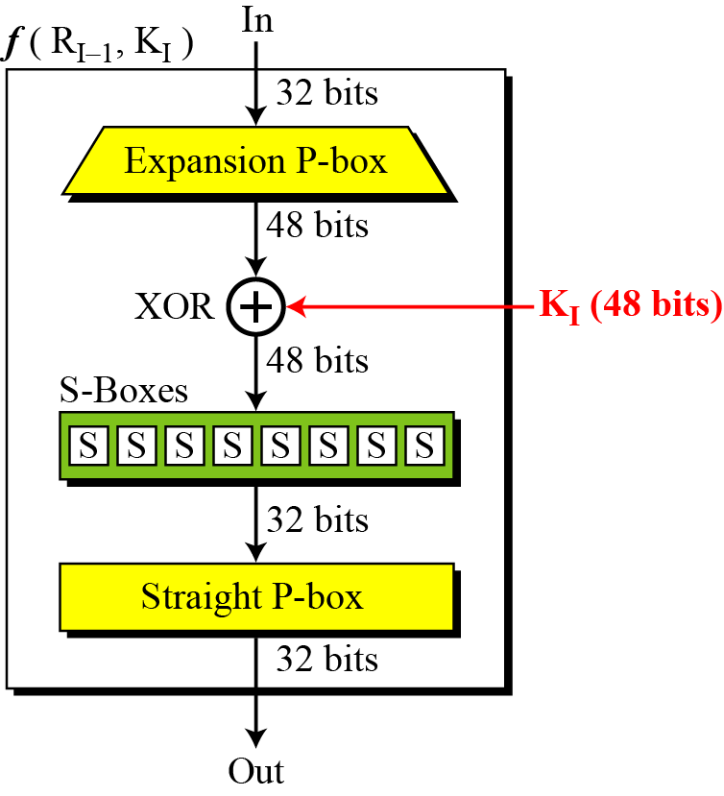
DES Function
The heart of DES is the DES function. The DES function applies a 48-bit key to the rightmost 32 bits to produce a 32-bit output.
Figure DES function

Slide 15
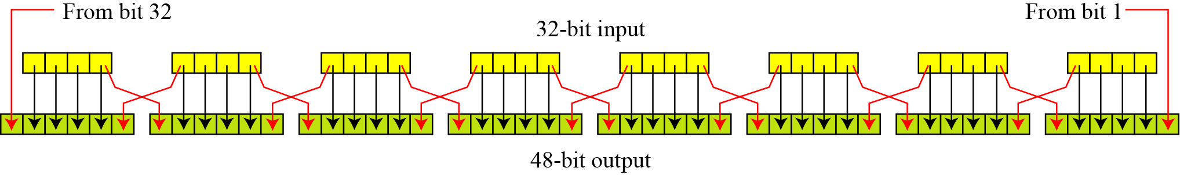
Expansion P-box
Since R_{I−1} is a 32-bit input and K_{I} is a 48-bit key, we first need to expand R_{I−1} to 48 bits.
32 bits = 8 * 4
48 bits = 8 * 6 1234
So convert each 4 bits to 6 bits 0 1234 5
0 is last bit of previous nibble
5 is first bit of next nibble
Figure. Expansion permutation

Slide 16
Expansion P-box
Conversion of a Nibble to 6 bits
DES uses a Table to define this P-box
Table Expansion P-box table

Slide 17
Whitener (XOR)
After the expansion permutation,
DES uses the XOR operation on
the expanded right section and the round key.
Both the right section and the key are 48-bits in length.
The round key is used only in this operation.

Slide 18
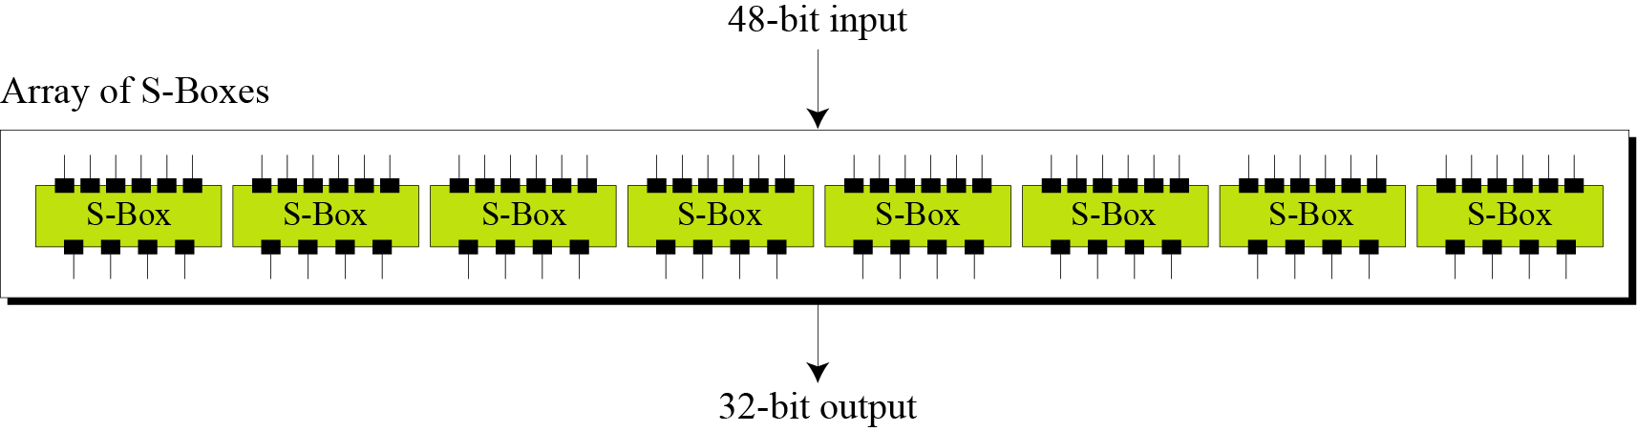
S-Boxes
The S-boxes do the real mixing (confusion).
DES uses
8 S-boxes, each with a 6-bit input and a 4-bit output.
Figure. S-Boxes

Slide 19
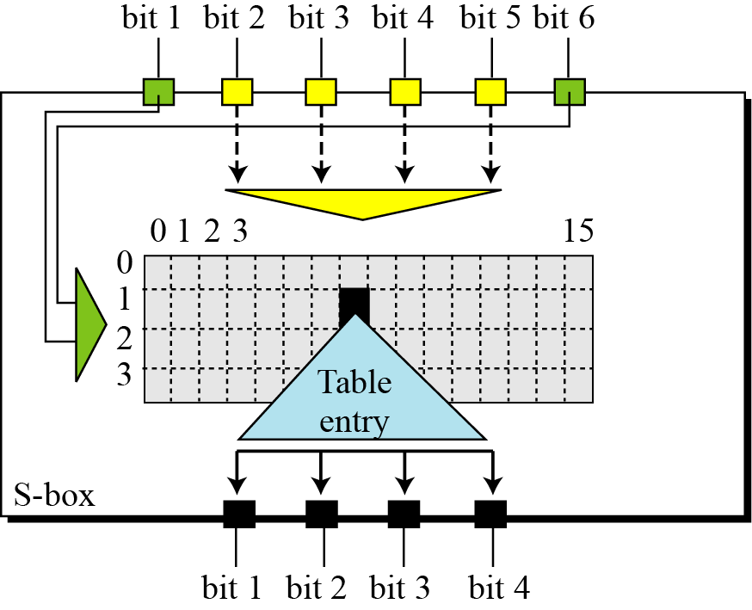
S-box
Figure S-box rule

Slide 20
Permutation for S-box 1
Table S-box 1

Slide 21
Permutation for S-box 1
Example
The input to S-box 1 is 100011. What is the output?

Slide 22
Permutation for S-box 1
Example
Solution
If we write the first and the sixth bits together,
11 in binary → 3 in decimal. --ROW
The remaining bits are
0001 in binary → 1 in decimal. ---COL
Look for the value in row 3, column 1, in Table (S-box 1).
The result is 12 in decimal, which in binary is 1100.
So the input 100011 yields the output 1100.
The input to S-box 1 is 100011. What is the output?

Slide 23
Permutation for S-box 1
Example
The input to S-box 8 is 000000. What is the output?
Solution
If we write the first and the sixth bits together, we get 00 in binary, which is 0 in decimal.
The remaining bits are 0000 in binary, which is 0 in decimal.
Look for the value in row 0, column 0, in Table (S-box 8).
The result is 13 in decimal, which is 1101 in binary. So the input 000000 yields the output 1101.

Slide 24
Straight Permutation
Table Straight permutation table

Slide 25
Cipher and Reverse Cipher
Using mixers and swappers, we can create the cipher and reverse cipher, each having 16 rounds.
Different Approaches
First Approach
Make the last round (round 16) different from the others;
it has only a mixer and no swapper.

Slide 26
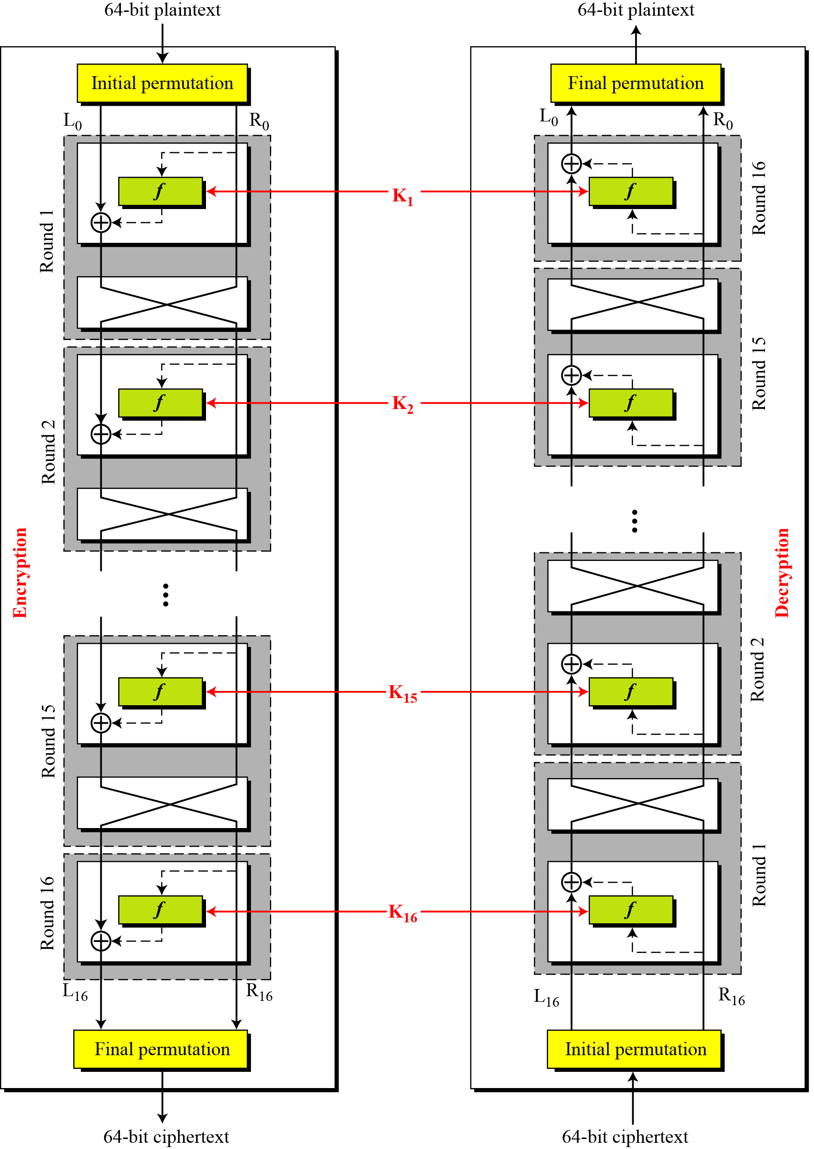
First Approach
Figure DES cipher and reverse cipher for the first approach

Slide 27
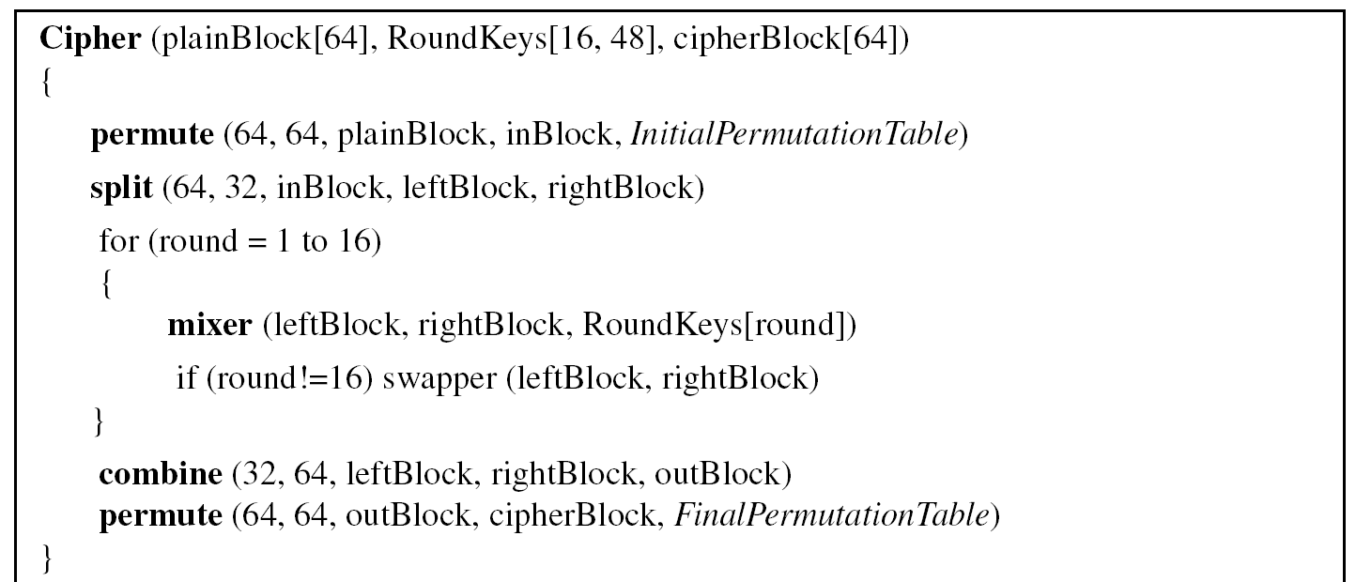
First Approach
Algorithm Pseudocode for DES cipher

Slide 28
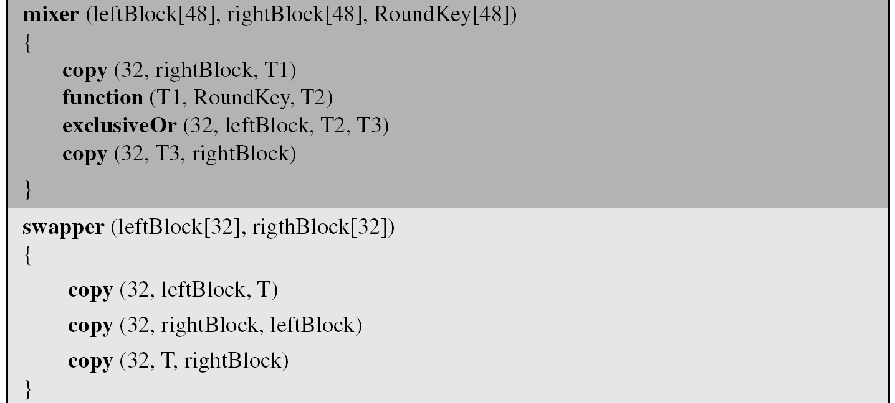
Algorithm
Algorithm Pseudocode for DES cipher (Continued)

Slide 29
Algorithm
Algorithm Pseudocode for DES cipher (Continued)

Slide 30
Algorithm
Algorithm Pseudocode for DES cipher (Continued)

Slide 31
Alternative Approach
Alternative Approach
Make all 16 rounds the same by including one swapper to the 16th round and add an extra swapper after that (two swappers cancel the effect of each other).

Slide 32
Key Generation
The round-key generator creates
sixteen 48-bit keys out of a 56-bit cipher key.

Slide 33
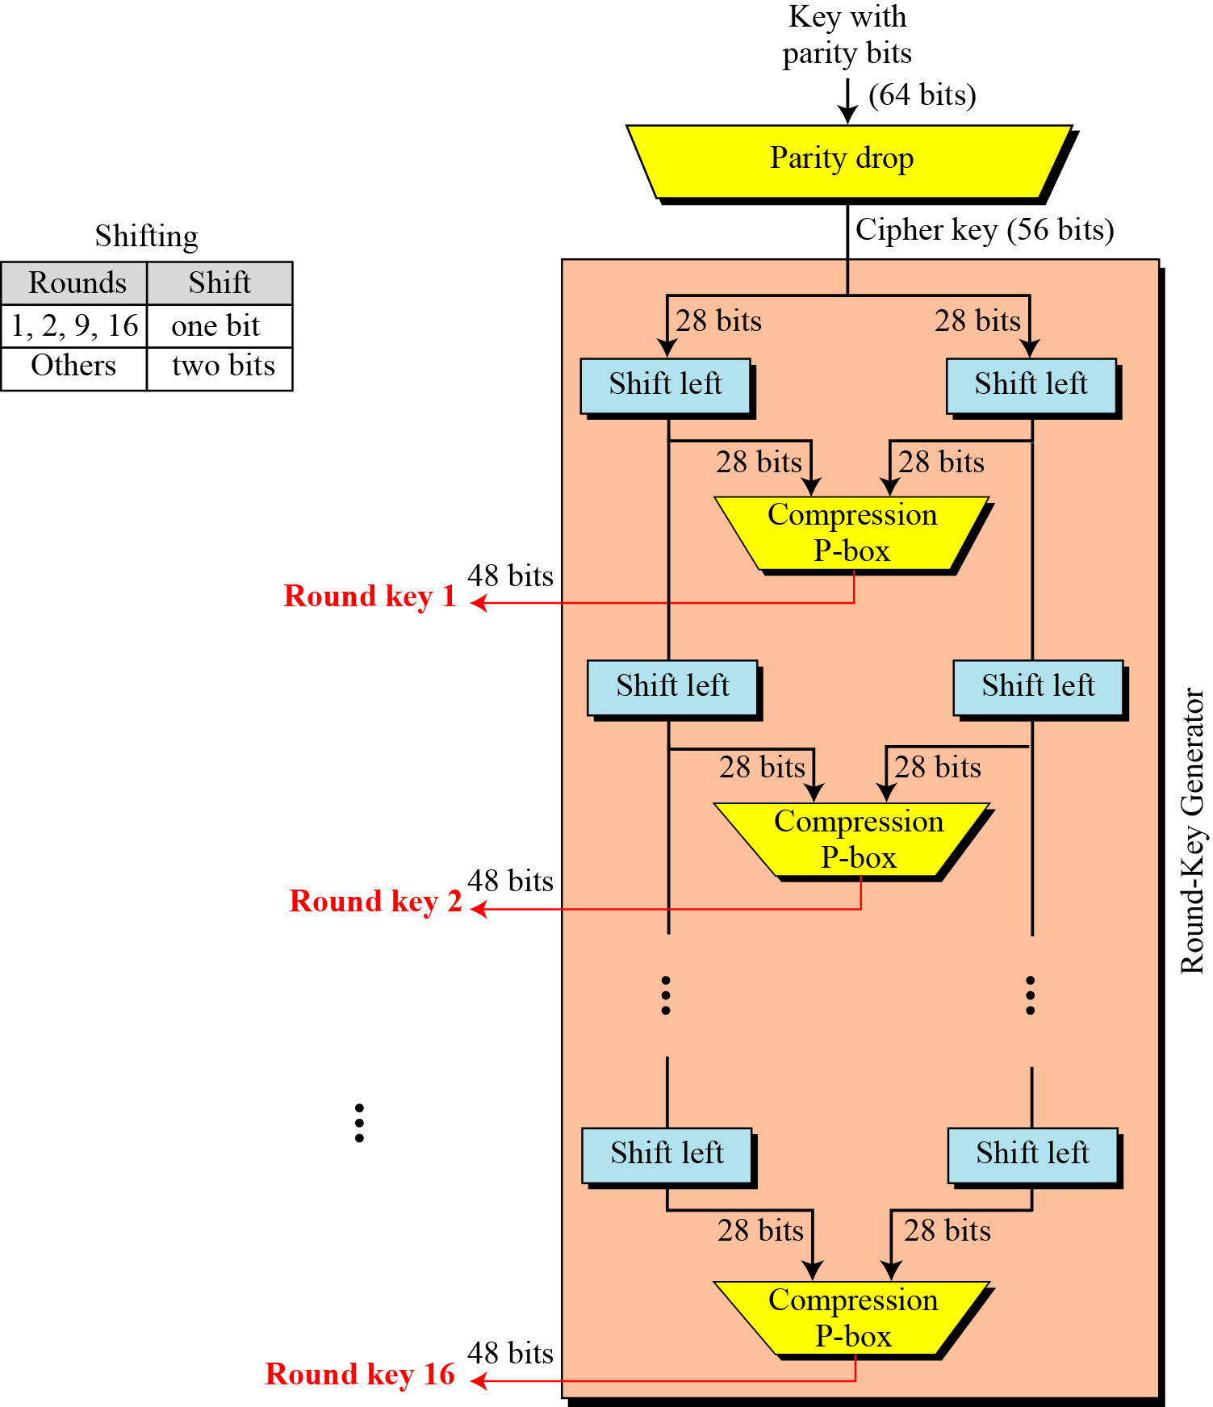
Key Generation
Figure Key generation

Slide 34
Key Generation
Table Parity-bit drop table
Table Number of bit shifts

Slide 35
Key Generation
Table Key-compression table

Slide 36
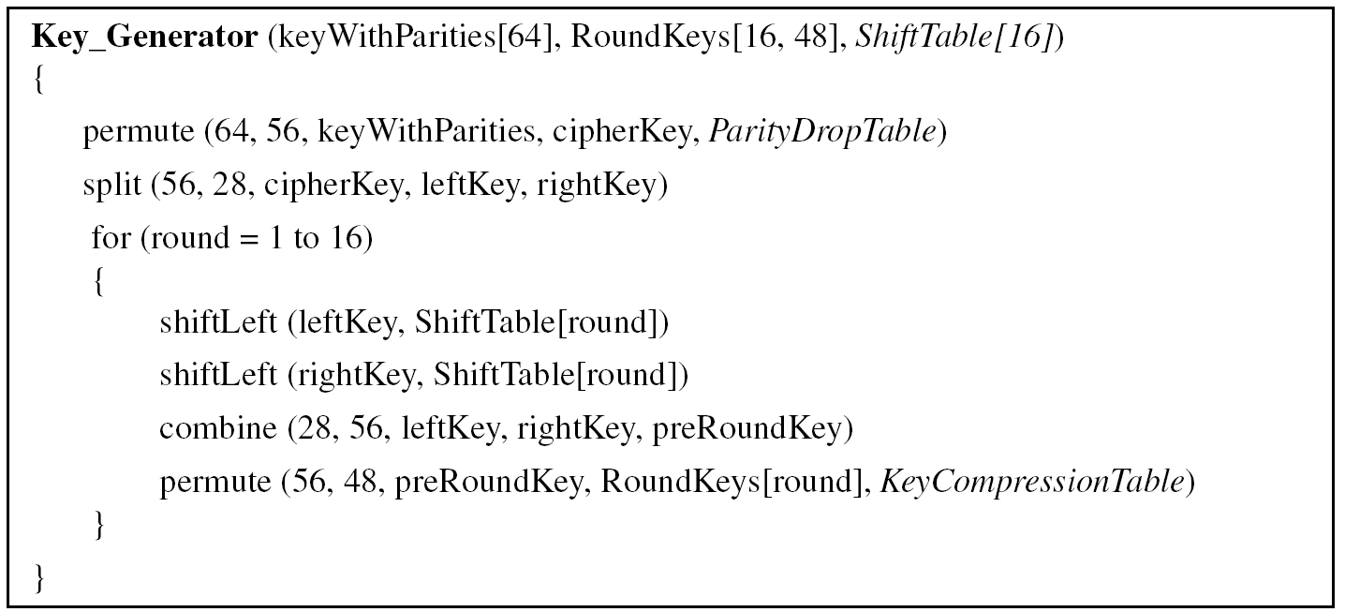
Algorithm for round-key generation

Slide 37
Shift Left

Slide 38
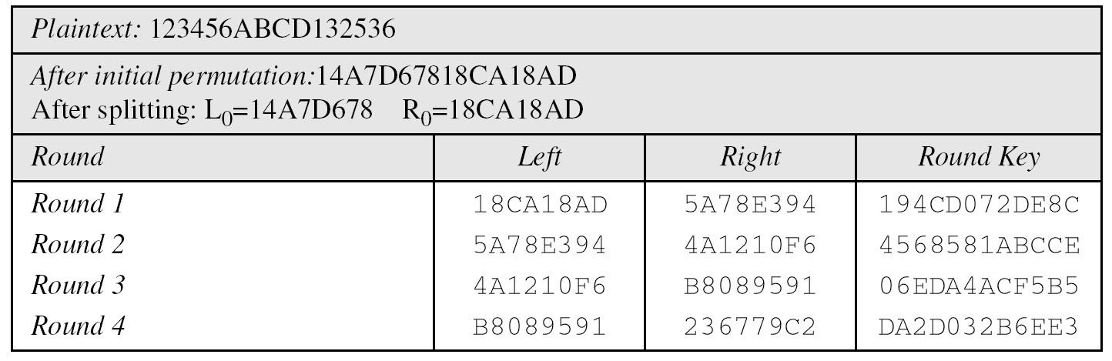
Examples
We choose a random plaintext block and a random key, and determine what the ciphertext block would be (all in hexadecimal):
Table 6.15 Trace of data for Example 6.5

Slide 39
6.2.4 Continued
Continued
Table 6.15 Trace of data for Example 6.5 (Conintued

Slide 40
6.2.4 Continued
Let us see how Bob, at the destination, can decipher the ciphertext received from Alice using the same key. Table 6.16 shows some interesting points.

Slide 41
DES ANALYSIS
Critics have used a strong magnifier to analyze DES. Tests have been done to measure the strength of some desired properties in a block cipher.
Two desired properties of a block cipher are the
avalanche effect
completeness

Slide 42
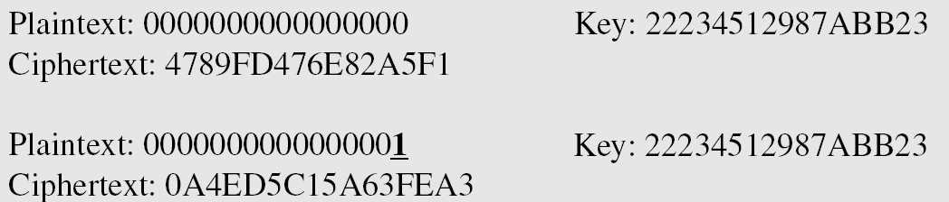
Avalanche Effect
A small change in the PT or key ( a single bit) should create a significant change in CT
To check the avalanche effect in DES, let us encrypt two plaintext blocks (with the same key) that differ only in one bit and observe the differences in the number of bits in each round.

Slide 43
Avalanche Effect
Though the two PT blocks differ only in the rightmost bit,
the CT blocks differ in 29 bits.
This means that changing approximately 1.5 percent of PT creates a change of approximately 45 percent in CT.
Table Number of bit differences

Slide 44
Completeness effect
Completeness effect means that each bit of the ciphertext needs to depend on many bits of the plaintext.

Slide 45
Security of DES
Among the attempted attacks on DES, three are of interest:
Brute-Force Attack
Differential Cryptanalysis
Linear Cryptanalysis

Slide 46
Brute-Force Attack
DES
weakness of short cipher key
Combined with the key complement weakness
can be broken using 2⁵⁵ encryptions.
Key domain is 2⁵⁶
But why 2⁵⁵ ???

Slide 47
Brute-Force Attack
DES
weakness of short cipher key
Combined with the key complement weakness
can be broken using 2⁵⁵ encryptions.
Key domain is 2⁵⁶
Half of the keys are complement of each other
2⁵⁶ / 2 = 2⁵⁵
In January 1999, distributed.net and the Electronic Frontier Foundation collaborated to publicly break a DES key in 22 hours and 15 minutes

Slide 48
Brute-Force Attack
DES
weakness of short cipher key
Combined with the key complement weakness
can be broken using 2⁵⁵ encryptions.

Slide 49
6.3.2 Design Criteria
S-Boxe
The design provides confusion and diffusion of bits from each round to the next.
P-Boxes
They provide diffusion of bits.
Number of Rounds
DES uses sixteen rounds of Feistel ciphers. the ciphertext is thoroughly a random function of plaintext and ciphertext.

Slide 50
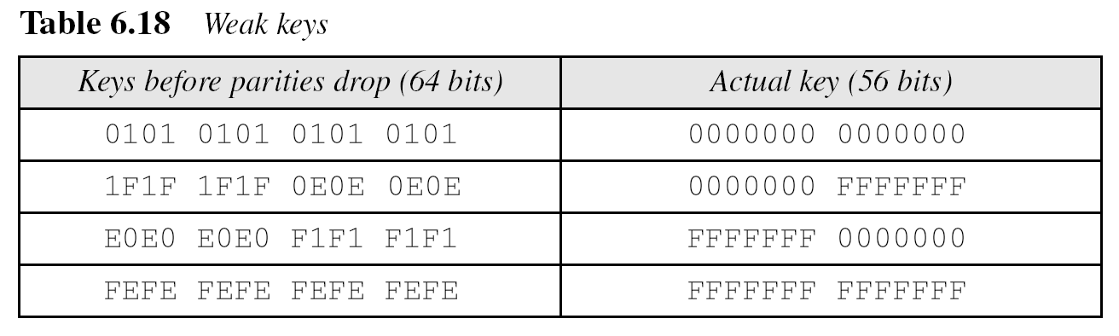
6.3.3 DES Weaknesses
During the last few years critics have found some weaknesses in DES.
Weaknesses in Cipher Design
1. Weaknesses in S-boxes
2. Weaknesses in P-boxes
3. Weaknesses in Key

Slide 51
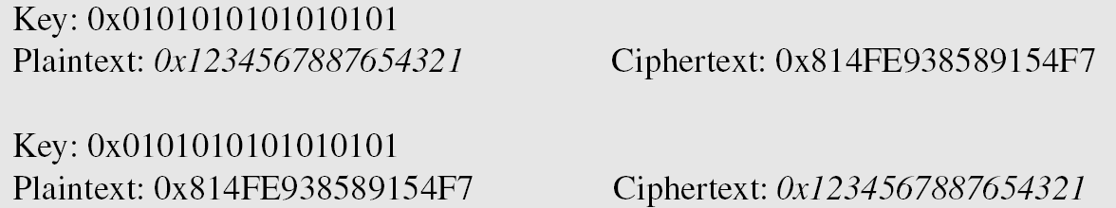
6.3.3 Continued
Example 6.8
Let us try the first weak key in Table 6.18 to encrypt a block two times. After two encryptions
with the same key the original plaintext block is created. Note that we have used the encryption algorithm two times, not one encryption followed by another decryption.

Slide 52
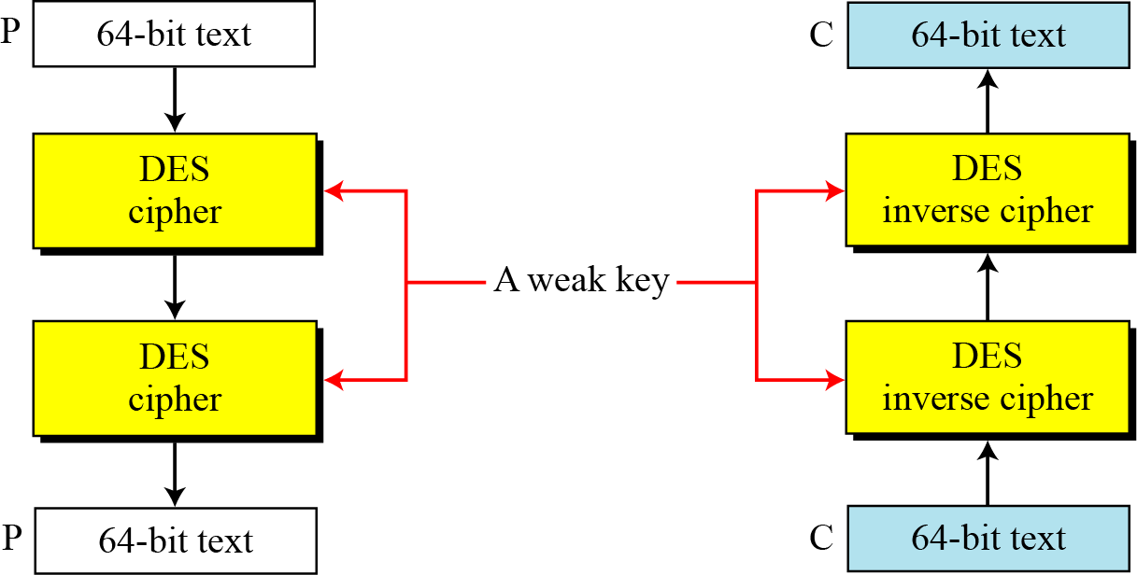
6.3.3 Continued
Figure 6.11 Double encryption and decryption with a weak key

Slide 53
6.3.3 Continued

Slide 54
6.3.3 Continued

Slide 55
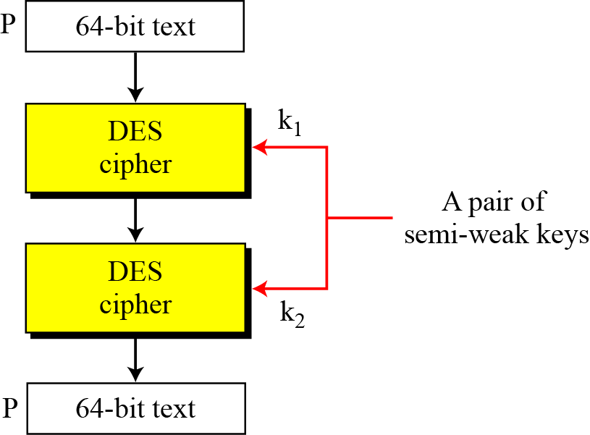
6.3.3 Continued
Figure 6.12 A pair of semi-weak keys in encryption and decryption

Slide 56
6.3.3 Continued
Example 6.9
What is the probability of randomly selecting a weak, a semi-weak, or a possible weak key?
Solution
DES has a key domain of 2⁵⁶. The total number of the above keys are 64 (4 + 12 + 48). The probability of choosing one of these keys is 8.8 × 10⁻¹⁶, almost impossible.

Slide 57
6.3.3 Continued

Slide 58
6.3.3 Continued
Example 6.10
Let us test the claim about the complement keys. We have used an arbitrary key and plaintext to find the corresponding ciphertext. If we have the key complement and the plaintext, we can obtain the complement of the previous ciphertext (Table 6.20).

Slide 59
6-4 Multiple DES
The major criticism of DES regards its key length. Fortunately DES is not a group. This means that we can use double or triple DES to increase the key size.
Topics discussed in this section:
6.4.1 Double DES 6.4.4 Triple DES

Slide 60
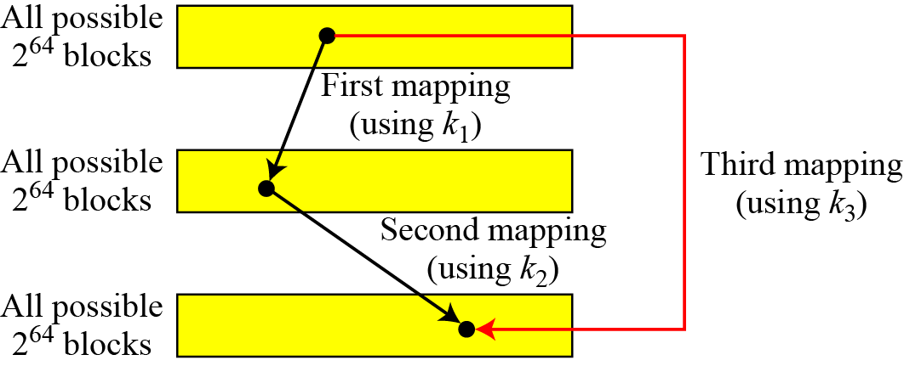
6-4 Continued
A substitution that maps every possible input to every possible output is a group.
Figure 6.13 Composition of mapping

Slide 61
6.4.1 Double DES
The first approach is to use double DES (2DES).
Meet-in-the-Middle Attack
However, using a known-plaintext attack called meet-in-the-middle attack proves that double DES improves this vulnerability slightly (to 2⁵⁷ tests), but not tremendously (to 2¹¹²).

Slide 62
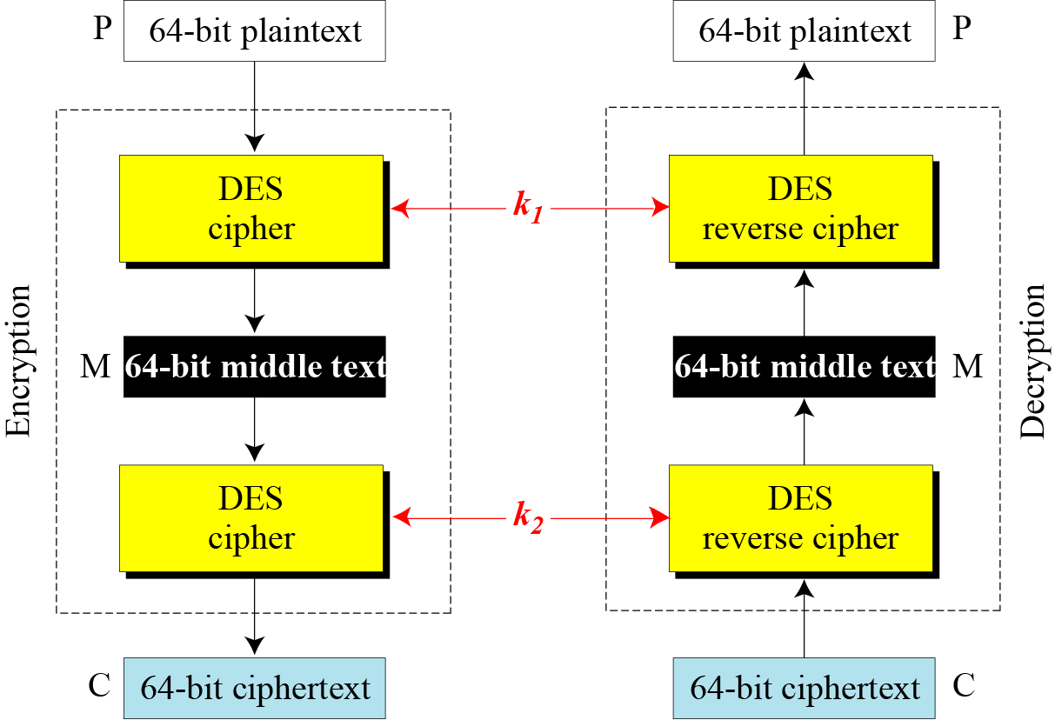
6.4.1 Continued
Figure 6.14 Meet-in-the-middle attack for double DES

Slide 63
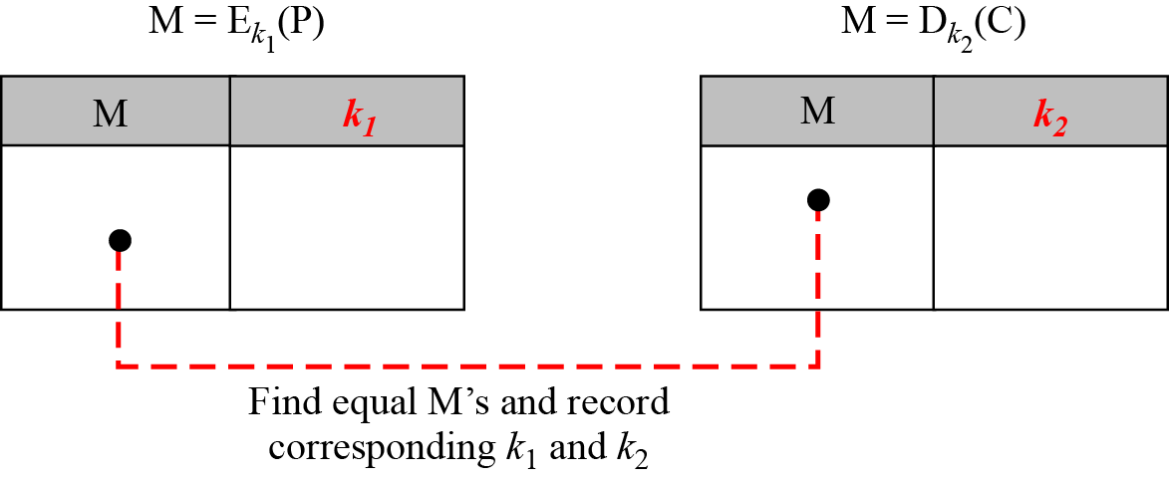
6.4.1 Continued
Figure 6.15 Tables for meet-in-the-middle attack

Slide 64
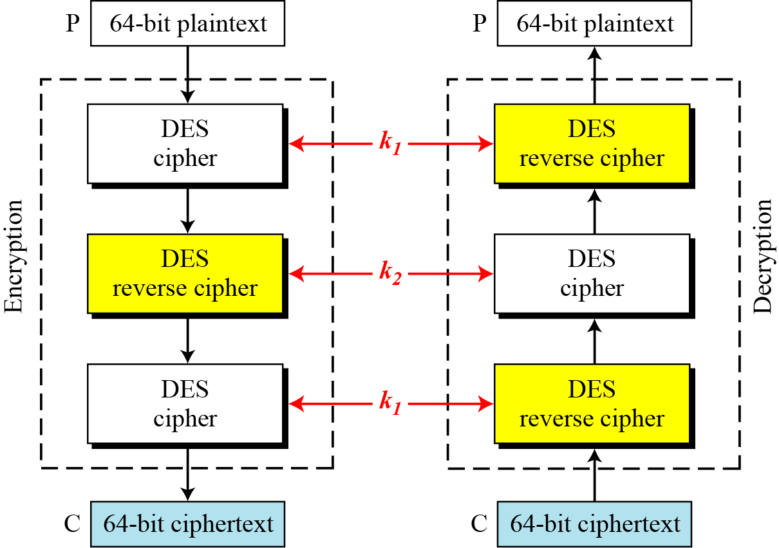
6.4.2 Triple DES
Figure 6.16 Triple DES with two keys

Slide 65
6.4.2 Continuous
Triple DES with Three Keys
The possibility of known-plaintext attacks on triple DES with two keys has enticed some applications to use triple DES with three keys. Triple DES with three keys is used by many applications such as PGP (See Chapter 16).

Slide 66
DES, as the first important block cipher, has gone through much scrutiny. Among the attempted attacks, three are of interest: brute-force, differential cryptanalysis, and linear cryptanalysis.
Brute-Force Attack - DES can be broken using 2⁵⁵ encryptions.
Differential Cryptanalysis
Linear Cryptanalysis
6-5 Security of DES

Slide 67
6.5.1 Brute-Force Attack
We have discussed the weakness of short cipher key in DES. Combining this weakness with the key complement weakness, it is clear that DES can be broken using 2⁵⁵ encryptions.

Slide 68

6.5.2 Differential Cryptanalysis
It has been revealed that the designers of DES already knew about this type of attack and designed S-boxes and chose 16 as the number of rounds to make DES specifically resistant to this type of attack.
Note
We show an example of DES differential cryptanalysis in Appendix N.

Slide 69
6.5.3 Linear Cryptanalysis
Linear cryptanalysis is newer than differential cryptanalysis. DES is more vulnerable to linear cryptanalysis than to differential cryptanalysis. S-boxes are not very resistant to linear cryptanalysis. It has been shown that DES can be broken using 2⁴³ pairs of known plaintexts. However, from the practical point of view, finding so many pairs is very unlikely.
Note
We show an example of DES linear cryptanalysis in Appendix N.

